Slide 1

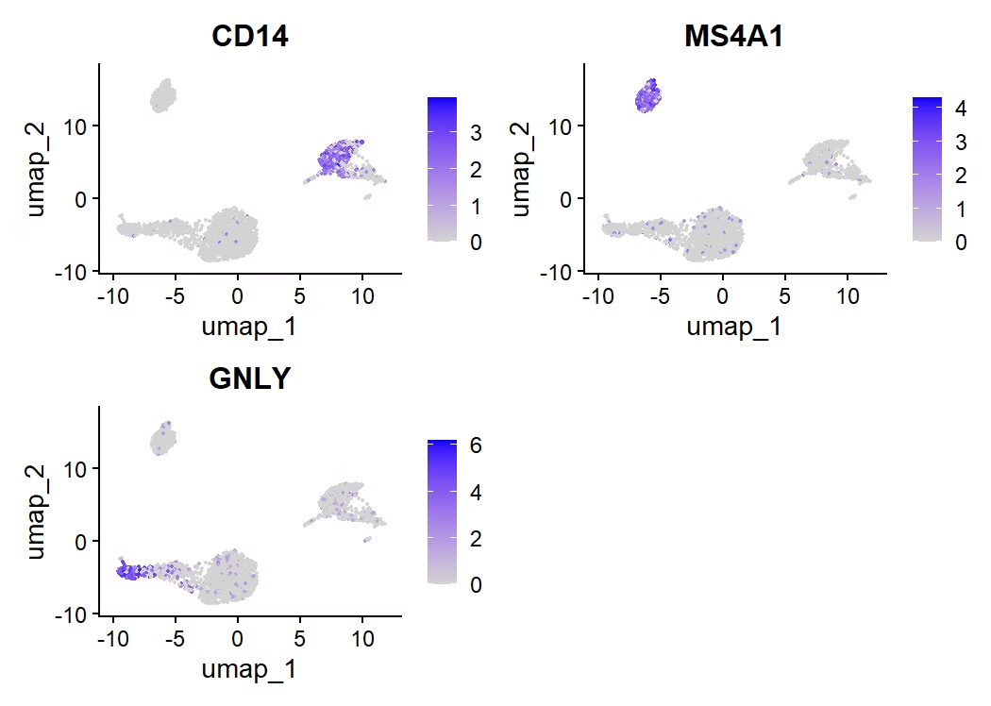
Single-cell PBMC Analysis in Lupus (SLE)
Multi-omics exploration of immune dysregulation: GSE189050 dataset (88,000+ cells)
scRNA-seq + CITE-seq of PBMCs comparing lupus vs healthy controls
Analysis pipeline: Seurat, UMAP, DEG, Marker identification

Slide 2

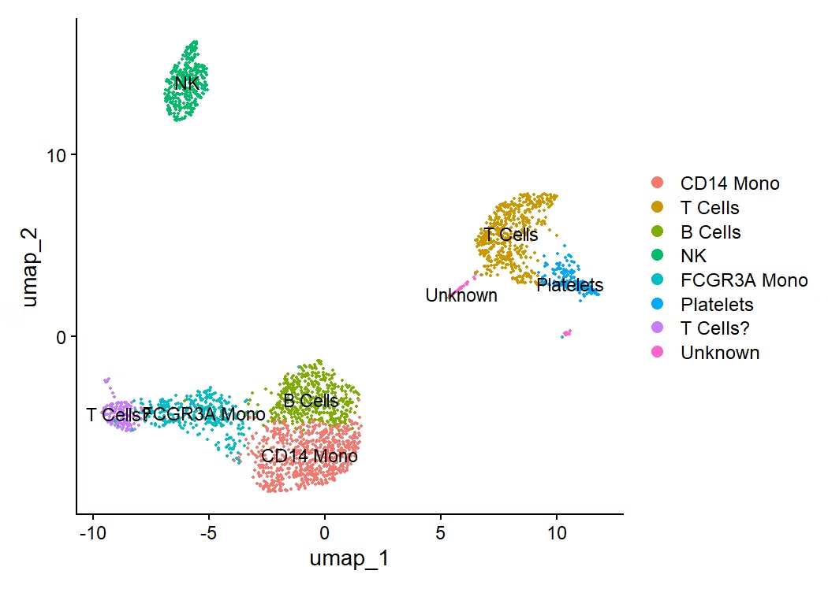



Cell Clustering and Annotation
Distinct PBMC Clusters
Key Marker Genes
CD14, MS4A1, GNLY/NKG7, CD3D identify major cell types
UMAP visualization reveals clear population separation
Validated Annotations
CITE-seq confirms cell identities via surface protein expression

Slide 3
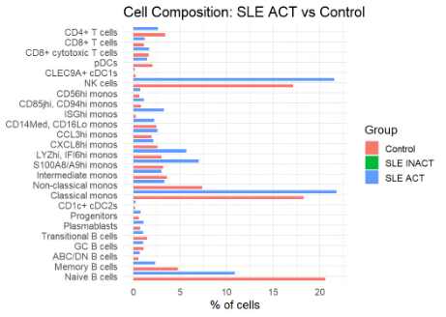



Disease Classification & Composition
Classical monocytes are significantly expanded in SLE ACT (~21%) compared to controls (~18%).
S100A8/A9hi monocytes, an inflammatory monocyte subtype, are more abundant in SLE ACT, suggesting heightened innate immune activation.
Memory B cells and CD8+ T cells are relatively decreased in SLE ACT, potentially reflecting immunological exhaustion or redistribution.
NK cells and interferon-responsive monocyte subsets (e.g., LY6Chi) are increased in active lupus, consistent with elevated type I interferon signaling
Active SLE
1
↑ Classical monocytes, pro-inflammatory shift
2
Inactive SLE
Intermediate immune composition
3
Healthy Controls
↑ Memory B cells, balanced immune profile
Disease status drives significant changes in immune cell proportions

Slide 4
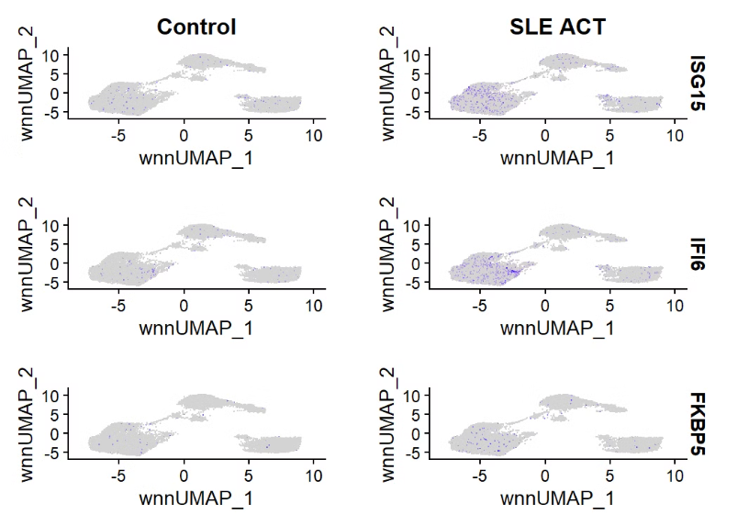
Gene Expression Differences
All three genes show increased expression in SLE ACT, supporting the role of type I interferon (IFN-I) signaling in active lupus.
ISG15 and IFI6 are classic interferon-stimulated genes, linked to antiviral responses and immune activation.
FKBP5 is associated with glucocorticoid signaling and immune regulation, suggesting stress pathway activation in SLE.
Elevated expression was especially prominent in monocyte subsets (as confirmed in UMAP plots and subset analysis)
ISGs (ISG15, IFI6, FKBP5) upregulated in active SLE
Monocyte subtypes show highest interferon response

Slide 5




Summary & Next Steps
Key Findings
Altered immune composition in active SLE
Upregulated interferon signature genes
Monocytes as key dysregulation drivers
Current Work
Integrating CITE-seq with transcriptomics
In-depth monocyte subpopulation analysis
Future Directions
Cytokine network analysis
Therapeutic target identification
Multi-omics integration pipeline development

